Slide 1
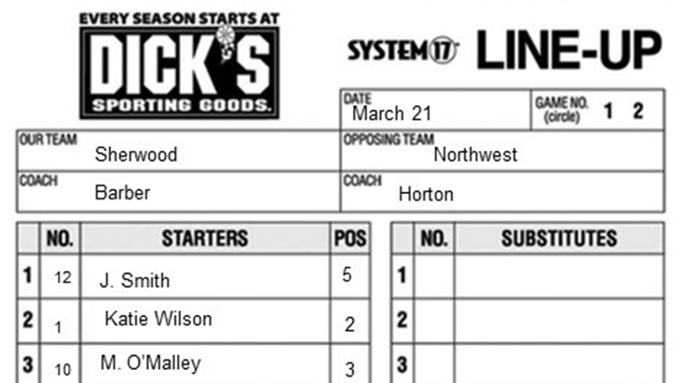

Batting Out of Order

Slide 2
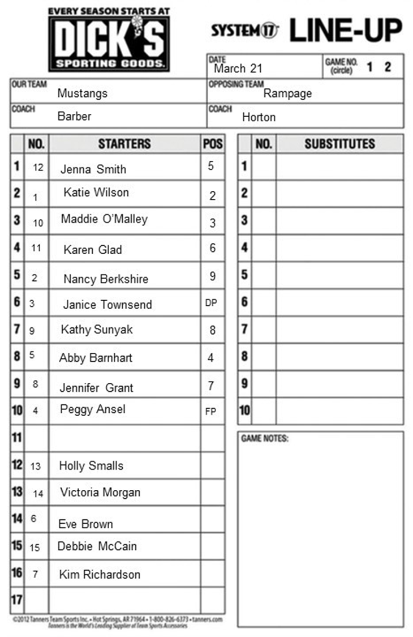
What happens when in batting out of order?
Batting out of order is one of four appeals listed in the rules book
Number 11 Karen Glad bats when Number 10 Maddie O’Malley should
Defense appeals while number 11 is still batting with a 2-1 count
Number 10 replace number 11 and has a 2-1 count
Number 11 bats when number 10 should, and number 11 completes the at bat
If identified before
The next pitch
All players leave the field and the catcher the catcher’s box
Consequences
The proper batter is out and loses her time at bat
Improper batter returns to the dugout or bats again (number 11 here bats again)
All outs stand
Runners not out return to the base occupied at the time of the pitch
Runner advance on stolen base, wild pitch, passed ball stands

Slide 3
What happens when in batting out of order?
Number 11 bats when number 10 should, and number 11 completes the at bat
If identified after
The next pitch, legal or illegal
Infielders leave the diamond and catcher the catcher’s box
Consequences
Improper batter’s time at bat becomes legal (number 11 is the proper batter)
Next batter would be number 2, Nancy Berkshire
Player bats out of order and is on base when it is her time to bat
Number 3 Janice Townsend bats for number 10 Maddie O’Malley and reaches 2nd
The batting out of order is not appealed by the defense
Number 10 then bats and then number 11 takes a pitch
Number 10 is now the proper batter, so number 11 completes her time at bat
Number 2 completes her time at bat and now number 3 should bat
Number 3 is on base so her time at bat is skipped
Number 9, Kathy Sunyak bats

