Slide 1
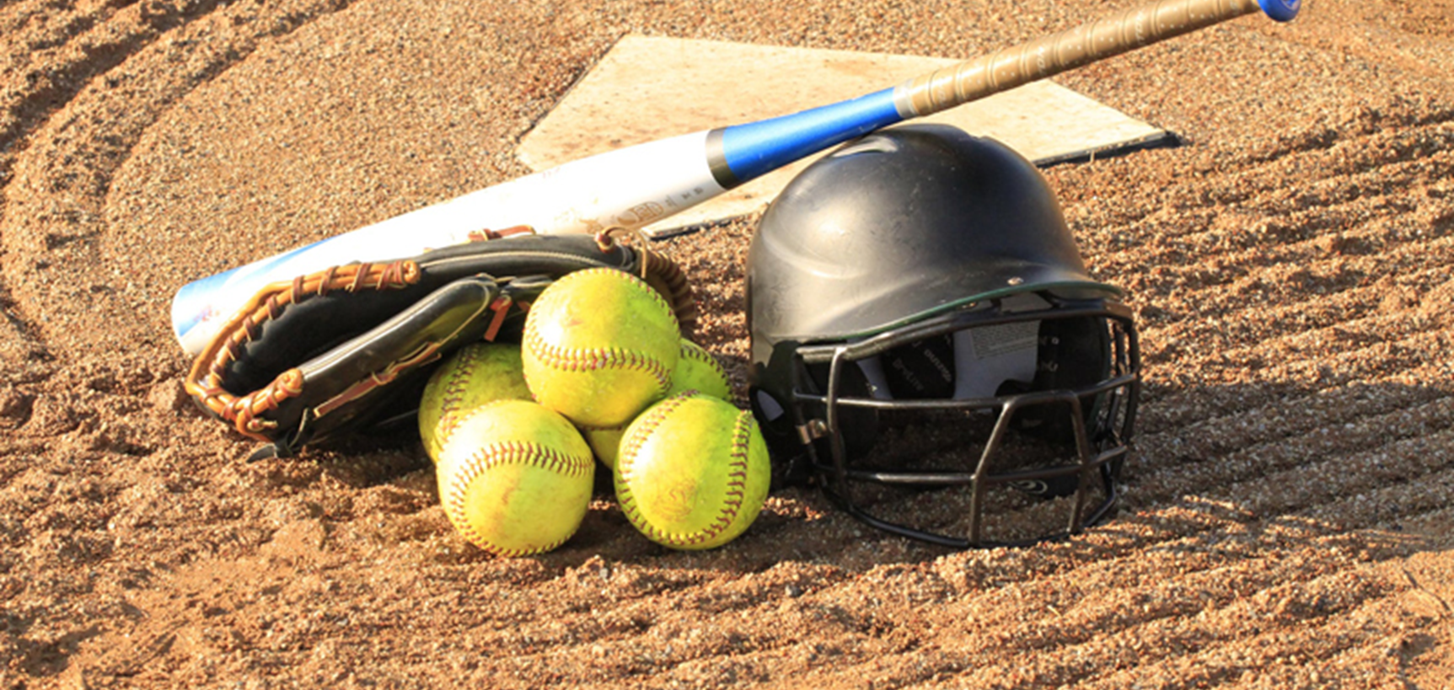

The Designated and FLEX Players in the Lineup
Notes:
This is Joe Holonich. I am an umpire and Training Coordinator for Softball Umpires of Maryland. This presentation covers the Designated Player, the DP, and the FLEX Player, FP or FLEX.

Slide 2
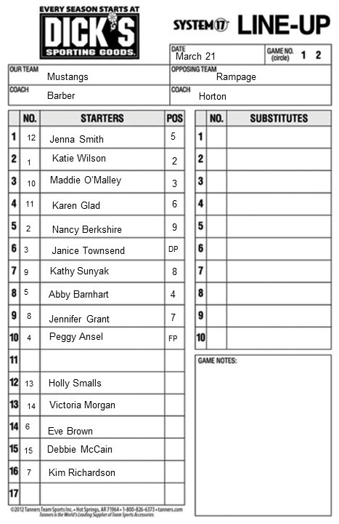
Use of Designated Player (DP) and FLEX Player (FP)
Must be known at pregame conference (shown on lineup card)
Not permitted with roster batting
Can only be used in regular lineup
Regular lineup can have 10, 11, or 12 players
11 players batting including the DP
Nine players in the classic lineup and two Additional Players
FLEX player
The DP
Designated to bat for one of the 9 starting defensive players
Has some defensive options
Remains in the same position in the lineup
The FLEX player
Placed in 10th, 11th, or 12th position in lineup
Has some offensive options
Notes:
When using a Designated Player, listed as the DP, and the FLEX players, listed as FP or FLEX in the lineup, it must be known at the pregame conference. The DP is designated to only bat for one of the nine starting players. You can see the DP position in the red circle. The DP does have some defensive options that will be discussed on the next slide. The DP remains in the same position in the lineup through the entire game. Janice Townsend has been identified as the DP during the pregame conference so that position in the lineup remains as the DP. In other words, if the DP plays defense for any player, other than the FLEX, the play who is now only batting does not become the DP. That player who was originally listed as the DP remains as the DP even if now playing defense. The FLEX player is listed in the 10 position on the lineup card as shown with the red circle The FLEX does not bat while in the 10th position. There are some offensive options for the FLEX that also will be discussed on the next slide. The DP and FLEX are tied together for the entire game. They may both play defense at the same time. However, the DP and FLEX can never play offense at the same time. If the FLEX plays offense for any lineup position other than the DP, that is an illegal substitution. The reason is that the FLEX does not have a right to be in any position on offense other than the DP. If the FLEX enters the game on offense at any position other than the DP, the illegal substitution penalty applies. The illegal substitution penalty is the removal of the illegal substitute from the game. She is restricted to the bench.

Slide 3

DP Substitutions
DP playing defense for any player other than FLEX is not a substitute
DP may be substituted any time
The player in the DP lineup positions leaves the game
Legal Substitute with DP position remaining in the lineup
FLEX playing offense for the DP
Original DP player has one reentry right
Cannot return to the game after her reentry right is used
Legal substitute can become the new player occupying the DP position
FLEX playing offense for the DP
Reduces the lineup from 10 to 9 players
If original DP player reenters or a legal substitute, FLEX can
Return to 10th position in lineup, or
Leave the game if the DP plays defense for the FLEX
Pos 9
13 Sub
4 Pos 1
3 RE
4 Return
Notes:
It is not a substitution if the DP plays defense for any position other than the FLEX player. It is merely a defensive change of positions. Substitutions for the DP may be made at any time. If a substitution for the DP occurs, the DP has left the game. The substitution can be made with any eligible substitute on the lineup card. If the FLEX plays offense for the DP, either batting or running, this is a substitution, and the DP has left the game. If a substitution is made for the DP, with either an eligible player off the bench of the FLEX, the original player in the DP position has one reentry right. Once the DP uses her reentry right, if she is removed again, she cannot reenter the game. The DP position can remain in the game if an eligible player off the bench or the FLEX player is substituted for her. If the FLEX takes the DP spot on offense, the FLEX is still in the game, and the FLEX player has not left the game. When the FLEX player plays offense for the DP, the lineup drops from 10 to 9. If the DP may reenter the game if she has not used her reentry right in her original lineup position, or an eligible substitute is placed in the DP position, the FLEX returns to the 10th position and the lineup again has 10 players. If the DP reenters the game or an eligible substitution is placed in the DP position, the FLEX may also be withdrawn from the game and the lineup remains at nine players. A legal substitute can be made for the FLEX player at any time and the lineup remains at 10 players. The DP may also play defense for the FLEX. In this lineup, the DP would be come the pitcher. If the DP plays defense for the FLEX player, the FLEX has left the game and has one reentry right. When the FLEX reenters the game, the DP can return to her original position in the lineup and bat or bat and play defense for another player. Alternately, the FLEX can take the DP position in the lineup card. In the former, the lineup returns to 10 players. For the latter, the lineup now has nine players. This concludes the presentation.

Slide 4
FLEX Player Substitution
FLEX playing offense for the DP
Cannot play offense for any other positions
Reduces the lineup from 10 to 9 players
If original DP player reenters FLEX can return to 10th position in lineup
FLEX has not left the game if returning to 10th position in lineup
Leaves the game if the DP plays defense for the FLEX
FLEX has one reentry right
Lineup returns to 10 if FLEX position returned
Lineup remains at 9 if FLEX takes the DP position
When can the FLEX be substituted
Any time by a legal substitute
One reentry right
On FLEX reentry DP can return to just offense or FLEX can bat
4 Pos 1
Pos 1
4 Pos 1
3 RE
4 RE
4 Pos 1
4 RE
14 Sub
Notes:
When using a Designated Player, listed as the DP, and the FLEX players, listed as FP or FLEX in the lineup, it must be known at the pregame conference. The DP is designated to only bat for one of the nine starting players. You can see the DP position in the red circle. The DP does have some defensive options that will be discussed on the next slide. The DP remains in the same position in the lineup through the entire game. Janice Townsend has been identified as the DP during the pregame conference so that position in the lineup remains as the DP. In other words, if the DP plays defense for any player, other than the FLEX, the play who is now only batting does not become the DP. That player who was originally listed as the DP remains as the DP even if now playing defense. The FLEX player is listed in the 10 position on the lineup card as shown with the red circle The FLEX does not bat while in the 10th position. There are some offensive options for the FLEX that also will be discussed on the next slide. The DP and FLEX are tied together for the entire game. They may both play defense at the same time. However, the DP and FLEX can never play offense at the same time. If the FLEX plays offense for any lineup position other than the DP, that is an illegal substitution. The reason is that the FLEX does not have a right to be in any position on offense other than the DP. If the FLEX enters the game on offense at any position other than the DP, the illegal substitution penalty applies. The illegal substitution penalty is the removal of the illegal substitute from the game. She is restricted to the bench.

