Slide 1

How to become an Umpire
Softball Umpires of Maryland
Mdumps.com

Slide 2


Intro

Slide 3
Where & When
Type
When
League Rec ball
Travel Tournament Ball
High School Ball
College Ball
Weekday Evenings
Weekends
Weekday Afternoons

Slide 4


Local Organization
Maybe we can help
uic@mdumps.com

Slide 5





National Organization
Benefits
Liability Insurance
Injury Insurance
Rule Books, Case Books, Mechanic Manuals
Access to Information

Slide 6

Rules
National Rules
Local Modifications

Slide 7
Training
Rules and Mechanics
SUM provides formal training Saturdays in January and February

Slide 8
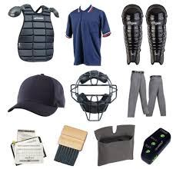
Equipment
Umpire Gear

Slide 9




What Now
SUM can help
Point of Contact uic@mdumps.com

Slide 10
Thank you
Softball Umpires of Maryland
Mdumps.com

