Slide 1

Legal Bats
Softball Umpires of Maryland
Mdumps.com

Slide 2
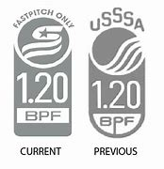
For a Bat to be Legal
It must be approved and have either
2014 Softball Stamp.
2020 Fast Pitch Stamp.
Can NOT be Altered or Damaged

Slide 3
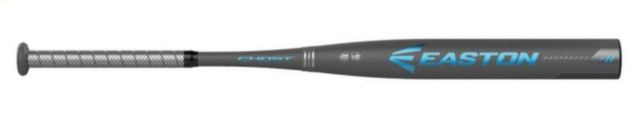

Beware the Ghost
Most Bats have dual certifications
Blue Ghost only USSSA
Yellow Ghost NOT USSSA

Slide 4



Legal USSSA Stamps but NOT Fast Pitch
Previous Baseball Stamp
Current Baseball Stamp
Current Slow Pitch Stamp

Slide 5
Altered Bat
May not change physical structure
Surface changed
Plug/knob removed
Remove, add, insert
Subject to pressure
Etc.
Tap on grip may be replaced

Slide 6
Damaged Bat
May not have
dents
cracks
Etc.

Slide 7
Penalty
Illegal Bat –
Bat removed
In batter’s box - batter out
Completed time at bat before next pitch – out & runners return
Non-Approved or Altered – player & coach ejected
Damaged due to contact – No violation

Slide 8
Thank you
Softball Umpires of Maryland
Mdumps.com

