Slide 1

Lineups
Softball Umpires of Maryland
Mdumps.com

Slide 2
Traditional Lineup
9 Players
Up to 2 Additional Players
Bat from 9 to 11
Substitutes listed at bottom
Must report when substitute enters game (to bat, run or play field)
To play defense, a substitute MUST be entered into the batting order.

Slide 3
Roster Batting
Must be declared before game
All Players batting
Any number of Additional Players
Bat the bench
No Substitutes
Any nine can play defense.

Slide 4
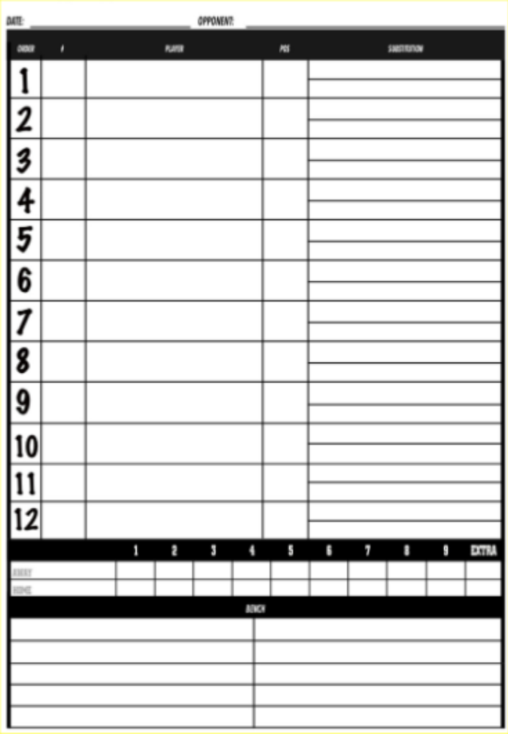
Line Up Card
Don’t Forget Team Name
First and Last Name
Number and Position
Listed in order batting
AP’s can be listed anywhere
Substitute Column on Right
should be left blank.
It is used when sub is made.
Substitutes listed at bottom. First and Last Name & Number
Must be present
Do not need to be present

Slide 5
Short Handed
Unfilled batting position
Can not play short handed if substitute available
Can start with 8
Can drop to 8 in batting lineup
Batting – Out
Injured on base – LCAB
May not return except under the blood rule

Slide 6
Adding Players
Players can be added with no penalty
Must fill any vacant slots
Traditional - Placed in Sub list
Roster – place last in batting order

Slide 7
Thank you
Softball Umpires of Maryland
Mdumps.com

