Slide 1
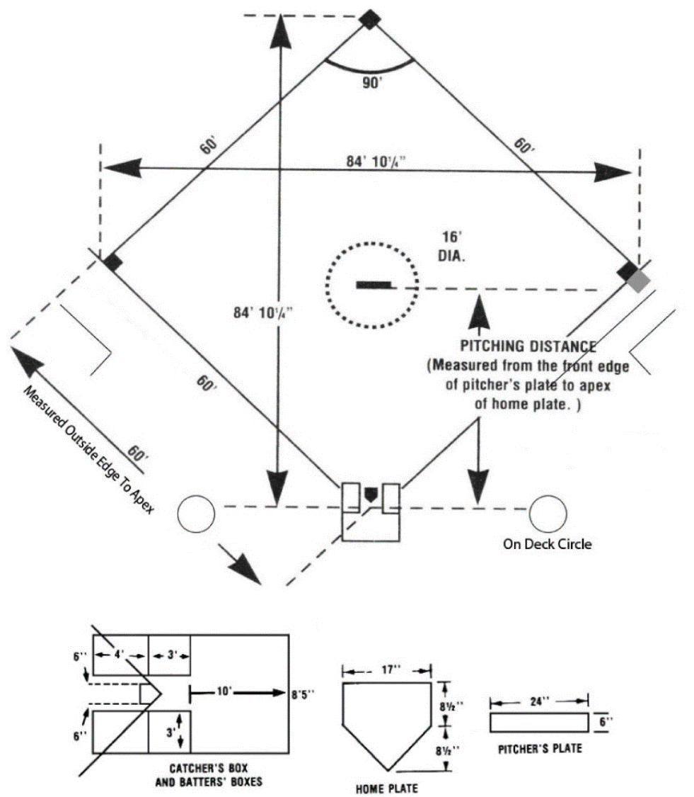

The On-Deck Circle and Batter
What you need to know!
Rule 1, Section 2
Rule 2, Section 12
Rule 7, Section 1, Item D

Slide 2
The On-Deck Circle and Its Use
Thirty-inch circle a safe distance from home plate
Available for next batter to warmup
Does not have to be used, but if it is…
One batter is permitted in the on-deck circle to warmup
Neither team is allowed to warmup in the other team’s on-deck circle
If a new pitcher is used during an inning, the batter must use her on-deck circle
Using your on-deck circle is for safety; defense is not looking for swinging bats on their side of the field

Slide 3
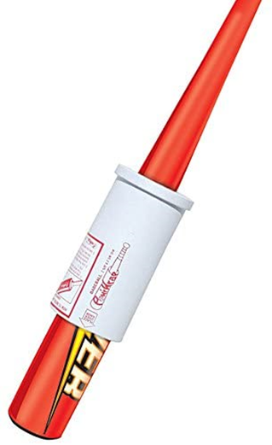
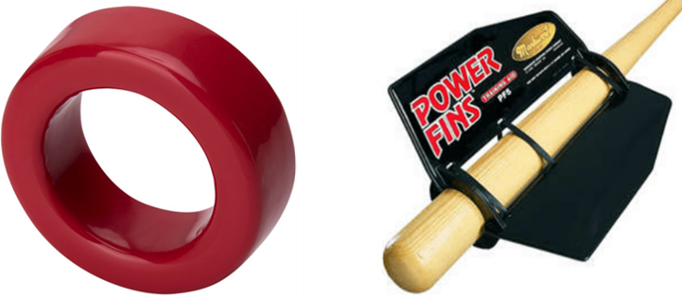
What is allowed in the on-deck circle?
Yes
Anything in the on-deck circle must be USSSA approved
No more than two bats
Warmup bat with parts permanently attached
Added devices
Commercially manufactured for a softball bat
Securely attached so as not to disengage
Take the general shape and size of a bat
Donuts and fans are not permitted
No

Slide 4
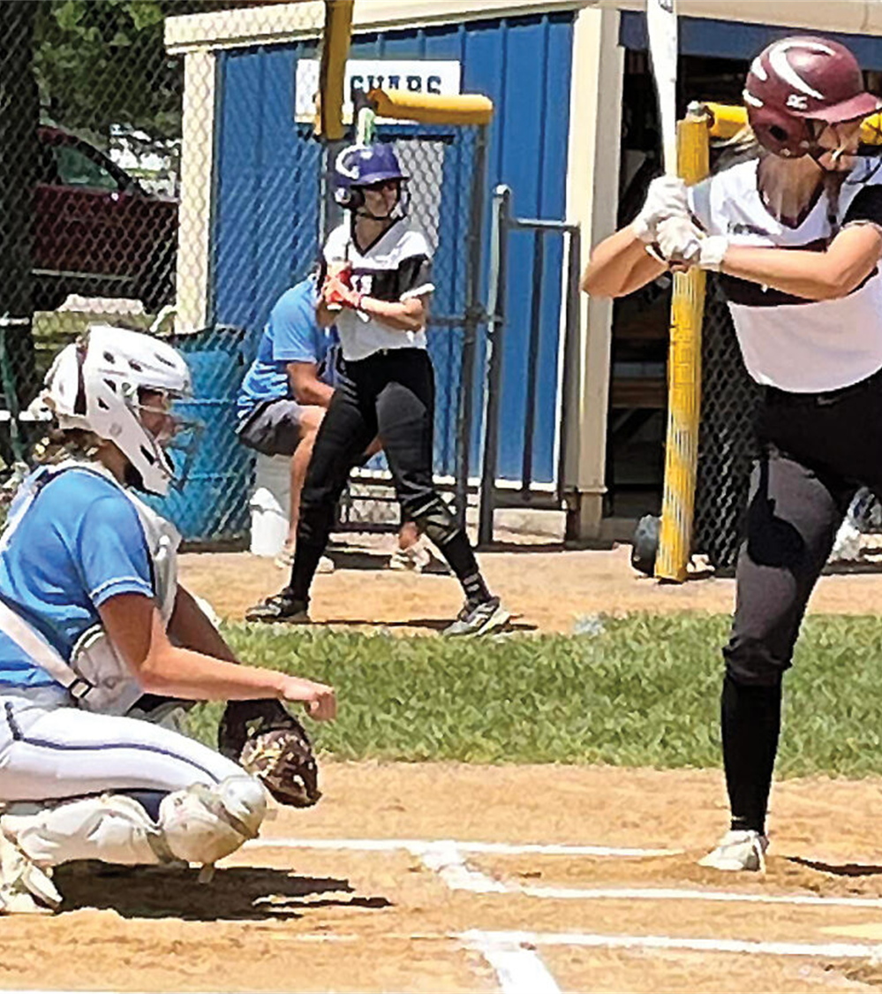
The On-Deck Batter
Is a player in the game but not yet playing offense
Should avoid touching a live ball
Touches a live ball
Creates a blocked ball
Becomes an immediate dead ball
Basis for interference
Interference by an on-deck batter
Batter is out if a fielder is attempting to catch the fly ball
Runner closest to home is out if defense is attempting a play
Interferes with a thrown ball, runner closest to home is out
Dead ball only on a thrown ball if no play is obvious

